Slide 1



Job Market Skills (FL601): Introduction to the Interview Process
Lesson 1: 27/01/23
Class Business
Setting up Mock Interview Groups
Skills Identification
Jobs in the Future of the IT Sector
Introduction to the Interview Process
Types of Job Interviews
Listening for Detail

Slide 2
Date | Lesson | Theme | Learning Outcomes/Objectives | Theme/Activities/Skills targeted | Resources
27/01/23 | 1 | Getting a job in the future of the IT/Engineering Sector | After completing this lesson students should be able to:- •Identify their skills (trained and transferable) •Use correct grammar in describing their skills •Learn useful skills for the IT industry and workplace •Learn useful employment vocabulary Recall the top personal skills employers look for which are essential for success Explain how they already demonstrate these skills in their everyday lives Evaluate how they can build on these skills and adapt them to a workplace setting | •Teacher led discussion on students’ skills •Grammar exercise on describing skills • Reading and vocabulary Read an article on Top skills that are in demand for IT in 2022 •Listening and vocabulary: Listen to an article on transferable skills •Teacher led activity: exercise to identify vocabulary for transferable skills | Reading Activity: (Trained Skills) https://barclayslifeskills.com/educators/lessons/recognising-and-building-personal-skills-lesson/ Listening Activity (transferable skills) https://barclayslifeskills.com/i-want-virtual-work-experience/school/transferable-skills-examples/

Slide 3
Identifying and Recognising your skills
1.1 Discussion - What are skills? - What are you skilled at? 1.2 What are skills? A skill is the ability to do something well. This can be divided into:- - Trained - Transferable skills

Slide 4
When talking about skills, use:-
Skilled at + Verb or skilled in + Verb
She is skilled at/in data analytics
Jennifer is skilled at/in machine learning
You can also use skilled at +verb - ing or skilled in +verb -ing
Hugo is skilled at/in programming language skills
They are skilled at/in analysing risk
You can also say that you are good at/in something
Efrei students are good at problem solving
They are also good in data modeling

Slide 5
(i) Trained Skills These are job specific trained skills gained from what you have studied at university or at the workplace. (ii) Transferable Skills. These are skills that you gain in real life and that can be transferable to the workplace, you just need to know how to describe them, especially because you have learned how to do it and practiced it. Many skills that you use on a day-to-day basis are transferable skills that employers love! You just need to describe them in the right way. Learning the lingo and applying these skills in a professional environment can help you get the job you want.

Slide 6
Transferable skills video We shall watch a video on Transferable skills https://barclayslifeskills.com/i-want-virtual-work-experience/school/transferable-skills-examples/

Slide 7
TASK Identifying transferable skills Put the right skill (leadership, problem solving, creativity, negotiating, time management, teamwork) next to the description You can haggle a brilliant bargain, or persuade people that something’s worth doing…………… If you’re the decision maker, everyone follows your lead, AND you can keep them motivated………………. You’re the go-to person to sort a tricky issue, then you’re a natural at ………………. You work well with others – whether it’s on a sports team or a project with others…………………….. You can fit a lot into a day or love a to-do list ……….. You are the one that always comes up with imaginative solutions – ………………
Notes:
Dernie

Slide 8
We shall watch a video on why these top skills are important in the workplace, and why it is good for students to be able to identify their own skills. https://barclayslifeskills.com/educators/lessons/recognising-and-building-personal-skills-lesson/
Skills for Success at Work

Slide 9
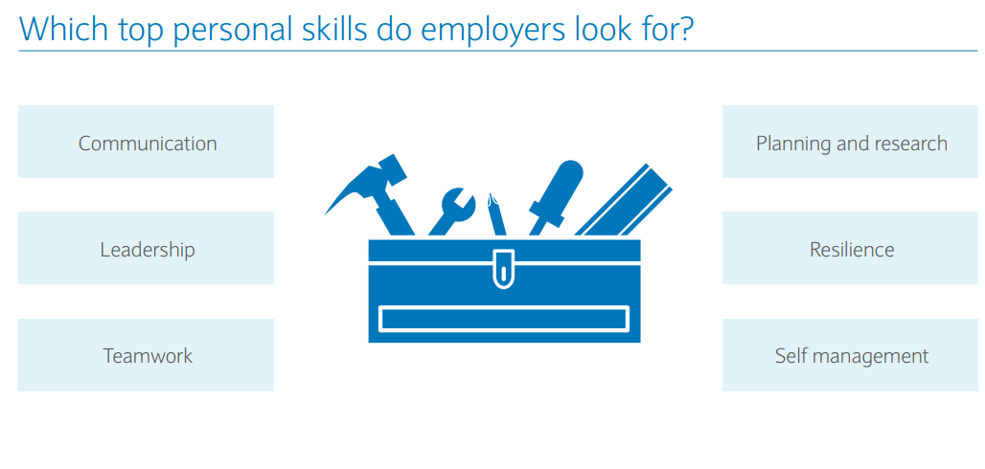
Skills for Success at Work

Slide 10
(i) Communication skills: Whether you’re speaking to a colleague or a customer, how you say something can be just as important as what you say at work. Show you’re really listening. Make sure there are no distractions when someone has something to say – you don’t want to miss anything important (ii) Working in a team Make sure everybody gets the opportunity to voice their opinion and give their perspective. As brilliant as you are, there may be something you haven’t thought about
Skills for Success at Work

Slide 11
(ii) Managing yourself There are lots of different organisational tools out there – from coloured pens and sticky notes to software, including spreadsheets. Find the ones that work for you (iv) Staying Positive Don’t kick yourself when you’re down! It’s not nice to feel you’ve made a mistake, but you can learn from it and do better next time
Skills for Success at Work

Slide 12
(ii) Managing yourself There are lots of different organisational tools out there – from coloured pens and sticky notes to software, including spreadsheets. Find the ones that work for you (iv) Staying Positive Don’t kick yourself when you’re down! It’s not nice to feel you’ve made a mistake, but you can learn from it and do better next time
Skills for Success at Work

Slide 13
Strengths
Strengths and how to identify them
Ask someone who knows you well to describe your strengths. They might describe you as a planner, a listener or a person who gets things done.
Although you might not think these things have anything to do with work, you’d be surprised how much employers value skills like these.
But how does that apply to my CV?
Now you’ve identified the skills and strengths that you use every day, you just have to translate them into workplace language. You might be someone who ‘gets the party going’, but you probably shouldn’t put that on your CV! Describing your ‘leadership and motivation skills’ would be better – these are skills employers are looking for. Reading job descriptions is a good way to learn the language of skills and work.
Look at the “Improving your Skills Sheet” and work with a partner to identify and share each other’s skills. (Task 1 – Teams)

Slide 14
Jobs in Demand in the IT Sector
Top IT Skills That Are in Demand in 2022 | CompTIA

Slide 15

Practice Makes Perfect
Coffee Break

Slide 16
Date | Lesson | Theme | Learning Outcomes/Objectives | Theme/Activities/Skills targeted | Resources
27/01 | 1 | Introduction to the Interview Process | After completing this lesson students should be able to:- • Understand that interviews help the employer and employee assess their match for one another • • Identify different types of interview and their purposes •Learn about different kinds of interview questions •Apply the STAR method to answer some common interview questions | Activities/Skills targeted Practicing interview skills using the STAR method Taking part in a virtual interview | Listening for detail Virtual online interview tool Virtual Interview Practice tool | Barclays LifeSkills

Slide 17
Discussion
What is an Interview and What Role Does it Play?

Slide 18
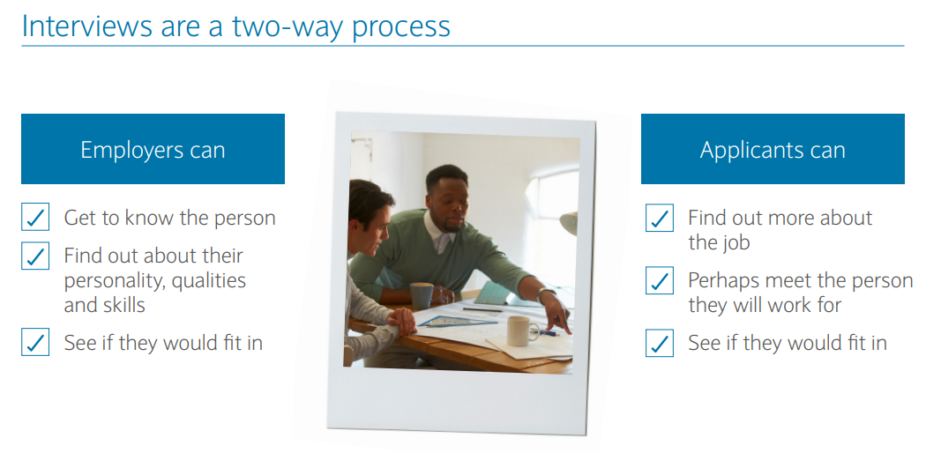
What is the purpose of an Interview?

Slide 19
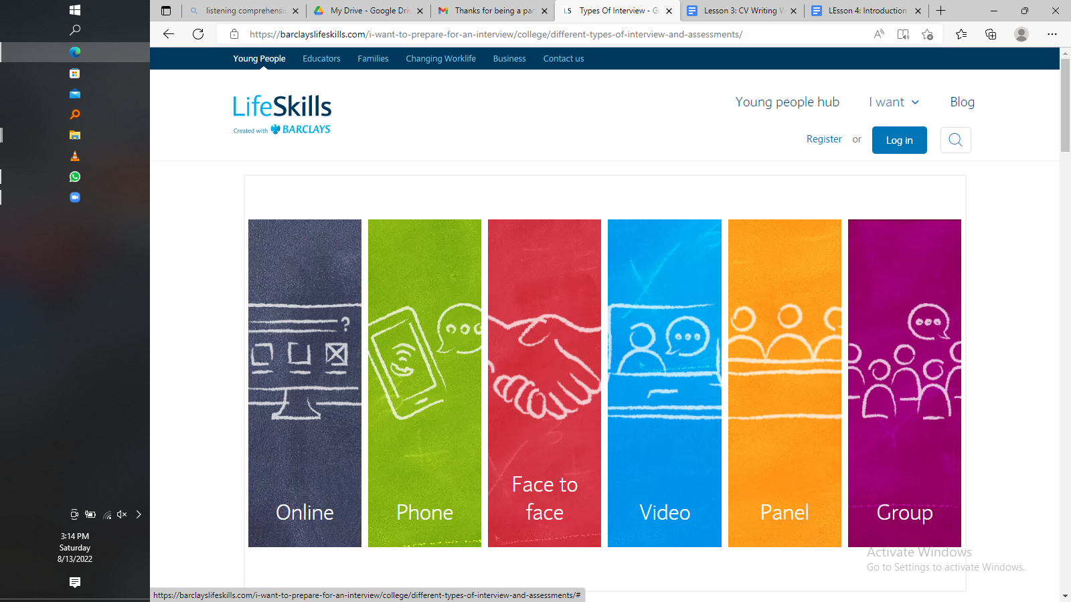
Types of Interviews
When you apply for a job, there are quite a variety of different types of interviews and assessments you might be asked to do and will vary depending on the type of role, the industry, or the stage you’re at in the interview process.
What type of interviews do you know?

Slide 20

1. The Online Interview
The Online Interview
This might be used to test specific abilities and/or judgement (e.g. a theory test)
Employers can assess skills including digital, online communication and problem solving

Slide 21

2. The Phone Interview
The Phone Interview
This can be used to find out if you sound like a good match for the role before an invitation to meet face-to-face
You can ask any questions you may have about the employer or role
Employers can assess your confidence, verbal communication and listening skills

Slide 22

3. The face to face Interview
The face to face Interview
This can be used to find out if you sound like a good match for the role before an invitation to meet face-to-face
You can ask any questions you may have about the employer or role
Employers can assess your confidence, verbal communication and listening skills

Slide 23

4. The Video Interview
The Video Interview
If the interview is in a different location, involves working remotely or from home, or you are unable to attend in person, a video call is a good replacement for a face-to-face interview
Video can be used to assess your confidence, face-to-face communication skills and to hear examples of key areas that are essential to the role (e.g. teamwork or problem solving)

Slide 24

5. The Panel Interview
The Panel Interview
Each person making up the panel could be assessing different things, and your role might link to each of theirs
Employers can evaluate how well you speak under pressure and to an audience

Slide 25

6. The Group Interview
The Group Interview
Employers can discover stand-out candidates within a group or when hiring for multiple roles
Candidates may be asked to complete tasks rather than answer questions
Especially used to assess teamwork and leadership skills, as well as communication and problem solving

Slide 26
The Eight Types of Interview Questions
There are eight basic types of questions you may face during the course of your interview:
1. Credential verification questions
This type of question includes "What is your GPA?" and "How long were you at _____?" Also known as resume verification questions. The purpose is to objectively verify the credentials presented in your background.
2. Experience verification questions
This type of question includes "What did you learn in that class?" and "What were your responsibilities in that position?" The purpose is to subjectively evaluate the experiences in your background.
3. Opinion questions
This type of question includes "What would you do in this situation?" and "What is your greatest weakness?" The purpose is to subjectively analyze how you would respond in a series of scenarios. The reality is that Response #43 in your brain

Slide 27
The Eight Types of Interview Questions
There are eight basic types of questions you may face during the course of your interview:
4. Behavioral questions
This type of question includes "Can you give me a specific example of how you did that?" and "What were the steps you followed to deliver that result?" The purpose is to objectively measure past behaviors as a potential predictor of future results.
5. Competency questions
This type of question includes "Can you give me a specific example of your leadership skills?" or "Explain a way in which you sought a creative solution to a recent problem you needed to solve." The purpose is to align your past behaviors with specific competencies which are required for the position.
6. Brainteaser questions
This type of question includes "What is 1000 divided by 73?" to "How many ping pong balls could fit in a Volkswagen?" to complex algorithms. The purpose is to evaluate not only your mental math calculation skills, but also your creative ability in formulating the mathematical formula for providing an answer (or estimate, as can often be the case).

Slide 28
The Eight Types of Interview Questions
There are eight basic types of questions you may face during the course of your interview:
7. Case questions
This type of question includes problem-solving questions ranging from: "How many gas stations are there in Europe?" to "What is your estimate for the global online retail market for books?" The purpose is to evaluate your problem-solving abilities and how you would analyze and work through potential case situations.
8. Nonsense questions
This type of question includes "What kind of animal would you like to be?" and "What color best describes you?" The purpose is to get past your pre-programmed answers to find out if you are capable of an original thought. There is not necessarily a right or wrong answer, since it is used primarily to test your ability to think on your feet.

Slide 29
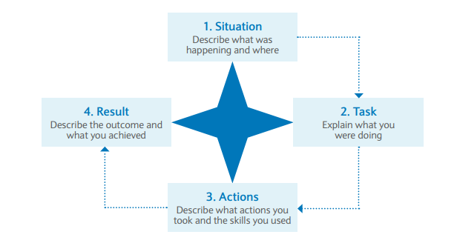
Introducing the S.T.A.R Interview Model
Interviews can be stressful and nerve-wracking, which can make it difficult to answer questions clearly and precisely. The STAR model is a useful way to approach interview questions because it can help you provide the detail that an employer might be looking for in a structured way.

Slide 30
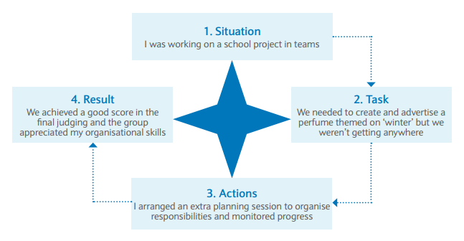
Introducing the S.T.A.R Interview Model
Let us look at an example of how the STAR model can be applied to the common interview question “Tell me about a time when you worked well in a team”. The person being interviewed has used their own personal experience of working in a group on a school project.

Slide 31

Questions You Can Ask During the Interview
Don’t forget to ask questions too.

Slide 32
Interactive Listening and Speaking Activity:
The Virtual Interview Practice Tool
With the help of a virtual interview practice tool, you will gain interview practice by listening to interview questions that you could be asked in real life interviews and practicing your answers.
Virtual Interview Practice tool | Barclays LifeSkills

Slide 33

The End.
Thank you for your time

